Slide 1

CST1302 Foundation of Web Programming – Lecture 2
A. A. Datti

Slide 2
Course Outline
Introduction to WWW
Structuring and Formatting with HTML
Introduction
HTML Tags and HTML Elements
Basic HTML Page Skeleton
Structure and Formatting
Basic Text Elements
Inline Formatting
Special Characters
Lists
Tables
Forms
Styling with CSS

Slide 3
Webpage and HTML
Web pages are the basic unit of a website, and every website is a collection of one or more pages.
Web pages are written in HTML (HyperText Markup Language).
HTML plays a key role in web pages: It tells browsers how to display the contents of a web page, using special instructions (called tags) that instruct the browser when to start a paragraph, italicize a word, or display a picture. To create your own web pages, you need to learn to use this family of tags.
HTML tags are formatting instructions that tell a browser how to transform ordinary text into something visually appealing. If you were to take all the tags out of an HTML document, the resulting page would consist of nothing more than plain, unformatted text.

Slide 4
HTML Tags
You can recognize a tag by looking for angle brackets, two special characters that look like this: < >.
To create a tag, you type HTML code between the brackets. This code is for the browser’s eyes only; web visitors never see it.
Essentially, the code is an instruction that conveys information to the browser about how to format the text that follows.
For example, one simple tag is the <b> tag, which stands for “bold” (tag names are always lowercase). When a browser encounters this tag, it switches on boldface formatting, which affects all the text that follows the tag. For example,
This text isn't bold. <b>This text is bold.
You can easily recognize an end tag. They look the same as start tags, except that they begin with a forward slash. They look like this </ instead of like this <. So the end tag for bold formatting is </b>. Here’s an example:
This isn't bold. <b>Pay attention!</b> Now we're back to normal.
Which a browser displays as:
This isn’t bold. Pay attention! Now we’re back to normal.

Slide 5
HTML Elements
The combination of start and end tags and the text in between them makes up an HTML element.
There are two types of elements:
Container elements: They apply formatting to the content nested between the start and end tags.
Standalone elements don’t turn formatting on or off. Instead, they insert something, like an image, into a page. E.g. the <br> element, which inserts a line break in a page. Standalone elements don’t come in pairs, as container elements do, and they are sometimes called empty elements because you can’t put any text inside them.

Slide 6
The Basic Skeleton
HTML documents are contained between the opening <html> and closing </html> tags. Inside these tags, the document is split into two sections:
The <head> element, which contains information about the document (such as a title or a link to a style sheet)
The <body> element, which contains the real content of the document that you see.
These four elements (<html>, <head>, <title>, and <body>.) should appear in every HTML document that you write, Remember that before an opening <html> tag, a HTML document should always contain a DOCTYPE declaration indicating which version of HTML it uses.
The <html> Element The <html> element is the containing element for the whole HTML document. After the DOCTYPE declaration, each HTML document should have an opening <html> tag and each document should end with a closing </html> tag.
Only two elements appear as direct children of an <html> element: <head> and <body> (although the <head> and <body> elements will usually contain many more elements).

Slide 7
The Basic Skeleton
To create a true HTML document, you start with three container elements: <html>, <head>, and <body>. These three elements work together to describe the basic structure of your page:
<html>
This element wraps everything (except the doctype) in your web page.
<head>
This element designates the header portion of your document. The header can include some optional information about your web page, including the required title (which your browser displays in its title bar), optional search keywords, and an optional style sheet (which we’ll learn later).
<body>
This element holds the meat of your web page, including the actual content you want to display to the world.

Slide 8
The Basic Skeleton
There’s only one right way to combine these three elements. Here’s their correct arrangement, with the HTML5 doctype at the beginning of the page:
<!DOCTYPE html>
<html>
<head>
...
</head>
<body>
...
</body>
</html>

Slide 9
HTML Elements - <HEAD>
The <head> element is just a container for all other header elements. It should be the first thing to appear after the opening <html> tag.
Each <head> element should contain a <title> element indicating the title of the document, although it may also contain any combination of the following elements, in any order:
<object>, which is designed to include images, JavaScript objects, Flash animations, MP3 files, QuickTime movies etc
<link> to link to an external file, such as a style sheet or JavaScript file.
<style> to include CSS rules inside the document.
<script> for including script in the document.
<meta>, which includes information about the document such as keywords and a description, which are particularly helpful for search applications.

Slide 10
HTML Elements - <TITLE>
The <title> Element
You should specify a title for every page that you write inside the <title> element (which is a child of the <head> element). It is used in several ways:
At the very top of a browser window
As the default name for a bookmark in browsers.
By search engines that use its content to help index pages.

Slide 11
HTML Elements - <BODY>
The <body> Element The <body> element appears after the <head> element and contains the part of the Web page that you actually see in the main browser window.
It may contain anything from a couple of paragraphs under a heading to more complicated layouts containing forms and tables, and is likely to constitute the majority of any HTML document.
Most of what you will be learning in this course will be written between the opening <body> tag and closing </body> tag.

Slide 12
Structure vs. Formatting
Before you start creating web pages with HTML markup, you should understand one other concept—the difference between structuring a document (dividing its content into discrete components like headings, paragraphs, lists, and so on) and formatting a document (making those components look pretty by applying italics, changing the text size, adding color, and so on).
Logical elements (also called semantic elements) define the individual components that make up your web page. They identify what in a page is a heading, a paragraph, a list, and so on. In other words, they tell you about the structure of your page.
Presentational elements (also called typographic elements) are all about formatting. Examples include elements that apply italics, boldface, underlining, and font settings to text.

Slide 13
HTML Elements for Basic Text
As you learned previously, you need to know two things about every new element you meet. To use an element correctly, you need to answer these two questions:
Is it a container element or a standalone element?
Is it a block element or an inline element?
The first question tells you something about the syntax you use when you add an element to a document. Container elements (like the <b> element that boldfaces text) require a start and end tag, with the content sandwiched in between. Standalone elements (like the <img> element that inserts an image into a page) use a single, all-in-one tag. If standalone elements need additional information, like the location of an image file, you supply it using attributes.
The second question tells you something about where you can place an element. Block elements (e.g. <p><h1><hr><ul>) go inside the main <body> element or within other block elements of a page. When you start building the overall structure of your page, you always begin with block elements. Inline elements (e.g <b><i><br><img><a>) have to go inside block elements. Inline elements don’t make sense when they’re on their own, floating free of any container.

Slide 14
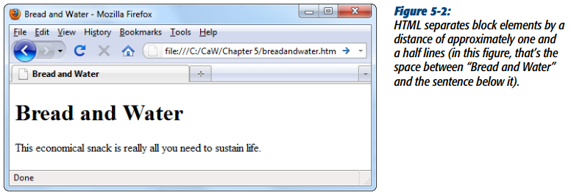
Block Elements
Block elements also have an effect on the spacing of your content. Essentially, each block element defines a chunk of content. When you end a block element, your browser automatically adds a line break and a little extra space before the next bit of content. For example, consider this fragment of HTML:
<h1>Bread and Water</h1><p>This economical snack is really all you need to sustain life.</p>

Slide 15
Paragraph <P>
It’s a block element that defines a paragraph of text.
The <p> element offers another way to structure your text. Each paragraph of text should go in between an opening <p> and closing </p> tag, as in this example:
<p>Here is a paragraph of text.</p>
<p>Here is a second paragraph of text.</p>
When a browser displays a paragraph it usually inserts a new line before the next paragraph and adds a little bit of extra vertical space
<p>This paragraph shows how multiple spaces between words are treated as a single space. This is known as white space collapsing, and the big spaces between some of the words will not appear in the browser.
It also demonstrates how the browser will treat multiple carriage returns (new lines) as a single space, too.</p>

Slide 16
LineBreak <br />
Sometimes you want to start a new line of text, but you don’t want to use a paragraph element because browsers add extra space between paragraphs.
In situations like this, the standalone line break element <br> comes in handy. Line breaks are exceedingly simple: They tell a browser to move to the start of the following line. They’re inline elements, so you need to use them inside a block element, like a paragraph:
<p>This paragraph appears<br /> on two lines</p>

Slide 17
Headings <h1> to <h6>
In HTML you have six levels of headings, which use the elements <h1>, <h2>, <h3>, <h4>, <h5>, and <h6>. While browsers can display headings differently, they tend to display the <h1> element as the largest of the six and <h6> as the smallest.
By default, most browsers display the contents of the <h1>, <h2>, and <h3> elements larger than the default size of text in the document. The content of the <h4> element would be the same size as the default text, and the content of the <h5> and <h6> elements would be smaller.

Slide 18
Horizontal Lines <hr />
Paragraphs and line breaks aren’t the only way to separate sections of text.
Another neat trick is the standalone <hr> element, which translates to “horizontal rule.”
A horizontal rule element adds a line that stretches from one side of its container to the other, separating everything above and below it.

Slide 19
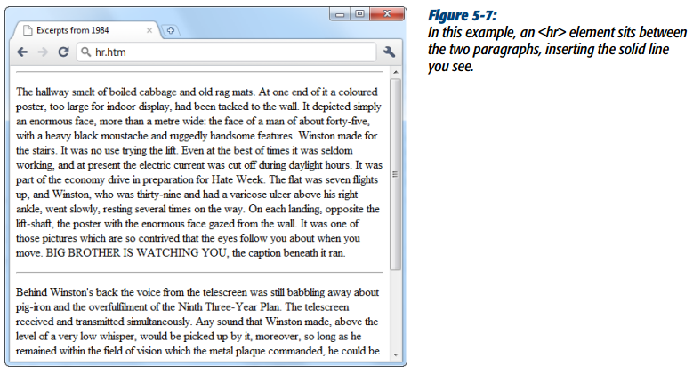
Horizontal Lines <hr />

Slide 20
Preformatted Text <Pre>
Preformatted text is a unique concept in HTML that breaks the rules you’ve read about so far. As you’ve seen, web browsers ignore multiple spaces and flow your text to fit the width of a browser window.
The <pre> element gives you a better option. It tells your browser to re-create the text just as you entered it, including every space and line break. Additionally, the browser puts all that text into a monospaced font (typically Courier), further setting this content off from the rest of the page.
<p>This is an infinite loop in Visual Basic:
<pre>
Do
X = X + 1
Loop Until X < 0
</pre>
</p>

Slide 21
Blockquote <blockquote>
The architects of HTML created a block element named <blockquote> especially for long quotations.
When you use this element, your browser indents text on the left and right edges.
For single line quotations, you can use the <q>…</q> element.
<p>Some words of wisdom from "A Tale of Two Cities":</p>
<blockquote>
<p>It was the best of times, it was the worst of times, it was the age of wisdom, it was the age of foolishness, it was the epoch of belief, it was the epoch of incredulity, it was the season of Light, it was the season of Darkness, it was the spring of hope, it was the winter of despair, we had everything before us, we had nothing before us…
</p>
</blockquote>
<p>It's amazing what you can fit into one sentence…</p>

Slide 22
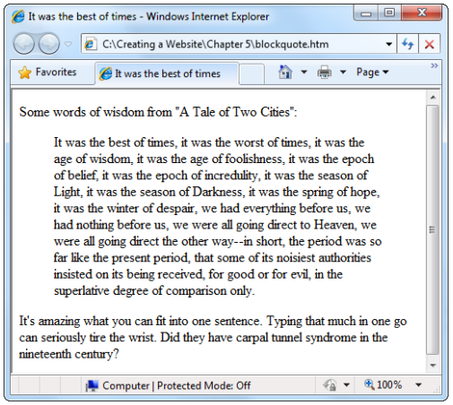
Blockquote

Slide 23
Inline Formatting with HTML
As you learned earlier, it’s best not to format with HTML too heavily.
To get maximum control over your pages’ appearance and to more easily update your website’s look later on, you should use to style sheets.
However, a few basic formatting elements are truly useful. You’re certain to come across them, and you’ll probably want to use them in your own pages.
These elements are all inline elements, so you use them inside a block element, like a paragraph, a heading,

Slide 24
Inline Formatting with HTML
Bold and Strong
Anything that appears in a <b> element is displayed in bold. Strong <strong> has the same effect.
Italic and Emphasis
The content of an <i> element is displayed in italicized text. So also the <em> tag.
Sub/Super-Script
The content of a <sup> element is written in superscript; the font size used is the same size as the characters surrounding it but is displayed half a character’s height above the other characters
The content of a <sub> element is written in subscript; the font size used is the same as the characters surrounding it, but is displayed half a character’s height beneath the other characters.
Delete and Mark
The <del> element, which is generally represents deleted text in a revised document or text that doesn’t apply anymore. The browser displays this text, but crosses it out with a horizontal line. The <mark> element is for highlighting text.

Slide 25
Special Characters
Copyright (&copy)
Registered trademark(&reg)
Trademark (&trade)
Euro (&euro)
Pound (&pound)
Yen (&yen)
Ampersand (&amp)
Less (&lt)
Greater Than (&gt)
Double quotation mark (&quot)

Slide 26
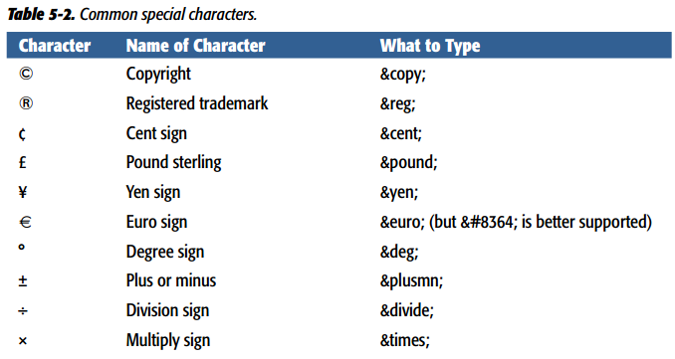
Special Characters

Slide 27
